Slide 1
CYBER SECURITY AND ARTIFICIAL INTELLIGENCE FOR CLOUD- BASED INTERNET OF TRANSPORTATION SYSTEMS

Slide 2
ABSTRACT
The "Cyber Security and Artificial Intelligence for Cloud-Based Internet of Transportation Systems" initiative combines cyber security, artificial intelligence, and cloud technology to enhance data integrity and user safety in interconnected transportation networks.
In the previous development, IOT is been used to store the data which will be transferred to autonomous vehicle. But this system have some drawbacks regarding security during data transfer.
The project uses CPABE encryption to secure files during upload, storage, and download.
Through distinct user and cloud server modules, it enables seamless interaction, encryption, and decryption while maintaining file integrity.
The project integrates AI-driven anomaly detection and robust cyber security measures, safeguarding cloud-based transportation systems against emerging threats.

Slide 3
INTRODUCTION
In the rapidly advancing landscape of technology, the integration of artificial intelligence (AI) and cyber security has become imperative, especially within the cloud-based Internet of Transportation Systems (IoTs).
As transportation systems become more interconnected and reliant on cloud infrastructure, the need to fortify these networks against cyber threats become paramount.
The introduction explores the intersection of AI and cybersecurity in the context of cloud-based IoTs, highlighting the significance of safeguarding transportation systems in an era of digital transformation.

Slide 4
PROBLEM STATEMENT
Intelligent Internet of Transportation Systems can be made by putting together artificial intelligence, cloud computing, cyber security, and the storage of data.
Social media platforms can be affected by both AVs and cyberattacks. This could put the privacy of social media users and the information they share at risk.
Cloud computing also poses some challenges for IoT applications, such as latency, bandwidth, reliability, and interoperability. Latency means the delay between sending and receiving data, which can affect the performance and responsiveness of IoT devices and applications.

Slide 5
OBJECTIVE
The primary objective is to enhance the cybersecurity framework of the cloud-based Internet of Transportation Systems (IoTs) integrated with artificial intelligence.
It also uses CP-ABE encryption method so that only authorized users can view the message. This includes:
Strengthening data protection: means implementing robust encryption and access controls to safeguard sensitive information.
Ensuring system reliability: means developing measures to prevent disruptions and downtime caused by cyber threats.
Enhancing AI resilience: Implementing defenses against adversarial attacks on AI algorithms used in transportation systems.
Continuous monitoring and adaptation: Establishing mechanisms for real-time threat detection and response to evolving cyber risks.

Slide 6
LITERATURE SURVEY
Integrating AI With Cyber Security for Smart Industry 4.0 Application:
https://ieeexplore.ieee.org/document/10134374
ABSTRACT: The advent of Smart Industry 4.0 has brought about significant advances in automation, efficiency, and productivity in industrial environments. However, these technological advances also pose new challenges for cybersecurity. The increasing interconnectivity of devices and systems within Smart Industry 4.0 environments makes them vulnerable to cyber attacks and security breaches. To address these challenges, there is a need to integrate AI with cybersecurity in Smart Industry 4.0 applications. AI can be used to analyze large amounts of data from sensors and devices within the industrial environment to detect and prevent cyber threats. Machine learning algorithms can be trained to identify patterns of normal behavior and flag any deviations as potential security threats. There are different AI-based cybersecurity techniques that can be used, such as anomaly detection, intrusion detection, and predictive analytics.

Slide 7
LITERATURE SURVEY
Trustworthy Machine Learning for Securing IoT Systems:
https://ieeexplore.ieee.org/document/9944835
ABSTRACT: This paper first describes the security and privacy challenges for the Internet of Things IoT) systems and then discusses some of the solutions that have been proposed. It also describes aspects of Trustworthy Machine Learning (TML) and then discusses how TML may be applied to handle some of the security and privacy challenges for IoT systems.

Slide 8
LITERATURE SURVEY
Enhancing Security and Scalability of Metaverse with Blockchain-based Consensus Mechanisms:
https://ieeexplore.ieee.org/document/10194035
ABSTRACT: This study examines how blockchain technology and consensus mechanisms can safeguard and grow the metaverse ecosystem. Blockchain is transparent and decentralized. It is unchangeable, cryptographically verified, and runs without a central authority. Blockchain technology can secure the metaverse and users' data. This study compares blockchain-based consensus algorithms such as POW(PoW), PoS, and PBFT to ensure metaverse safety. These consensus mechanisms provide safe, decentralized transaction verification, waste reduction, and network consensus. Studying blockchain technology's metaverse scaling restrictions and scaling solutions, including sharding, sidechains, and off-chain protocols. These methods increase throughput, parallel computing, and transaction speed.

Slide 9
LITERATURE SURVEY
Towards a Privacy-Aware Quantified Self Data Management Framework:
https://dl.acm.org/doi/abs/10.1145/3205977.3205997
ABSTRACT: Massive amounts of data are being collected, stored, and analyzed for various business and marketing purposes. While such data analysis is critical for many applications, it could also violate the privacy of individuals. This paper describes the issues involved in designing a privacy aware data management framework for collecting, storing, and analyzing the data. We also discuss behavioral aspects of data sharing as well as aspects of a formal framework based on rewriting rules that encompasses the privacy aware data management framework.

Slide 10
LITERATURE SURVEY
Application of User and Entity Behavioral Analytics (UEBA) in the Detection of Cyber Threats and Vulnerabilities Management:
https://www.researchgate.net/publication/370406719_Application_of_User_and_Entity_Behavioral_Analytics_UEBA_in_the_Detection_of_Cyber_Threats_and_Vulnerabilities_Management
ABSTRACT: Technological advancements such as the Internet of Things, mobile technology, and cloud computing are embraced by organizations, individuals, and society. The world is becoming more reliant on open networks, which fosters global communication and cloud technologies like Amazon Web Services to store sensitive data and personal information. This changes the danger landscape and opens new opportunities. As the number of people who use the Internet grows, so does the number of cyber risks and data security challenges that hackers pose.

Slide 11
EXISTING SYSTEM
The existing system faces significant cybersecurity vulnerabilities within its cloud-based internet of Transportation Systems (IoTs).
Weakness includes potential data breaches, system disruptions, and the susceptibility of AI algorithms to exploitation. These challenges compromise the integrity and safety of transportation networks, necessitating a comprehensive reassessment of the current security measures to fortify against evolving cyber threats in the rapidly advancing technological landscape.

Slide 12
DRAWBACKS OF EXISTING SYSTEM
Vulnerable to security breaches.
Risks associated with improper data transfers.
Increased susceptibility to cyber attacks and unauthorized access.

Slide 13
PROPOSED SYSTEM
In proposed system we are implementing Cyber Security (CS) based data transfer to Autonomous vehicle to overcome the existing problems. Here a cloud is the mediator that which transfers sender files to autonomous vehicle with more security we are using CP-ABE based algorithm which is used to hide the transferred data into cipher text. The cipher text can be decrypted by the private key generated by sender to the particular AV.

Slide 14
BENEFITS OF PROPOSED SYSTEM
Enhanced security measures bolster protection against breaches, ensuring robust defenses against unauthorized access and data compromise.
Precision in data transmission minimizes errors, optimizing reliability and promoting seamless, accurate information exchange.
Reduced cyber attack susceptibility through proactive measures fortifies systems, safeguarding against threats and enhancing overall digital resilience.

Slide 15
REQUIREMENTS
SOFTWARE
HARDWARE
1) FRAME WORK - FLASK/DJANGO
2) DATABASE - MYSQL WORK BENCH/SQLITE 3
3) USER INTERFACE LANGUAGES - HTML, CSS, JS, BOOTSTRAP 4
4) FRONTEND LANGUAGES - PYHTON
5) SOFTWARE INSTALLED - PYTHON IDLE (3.7.0)
1)Operating System : Windows Only
2)Processor : i5 and above
3)Ram : 8gb and above
4)Hard Disk : 25 GB in local drive

Slide 16
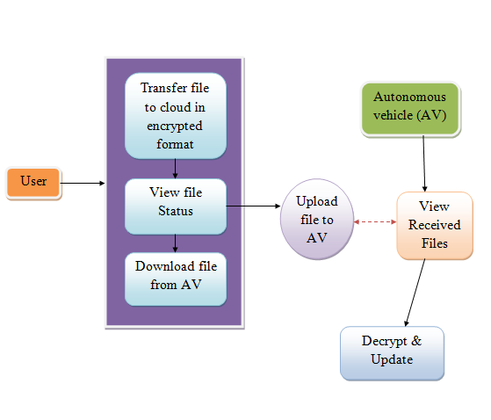
SYSTEM ARCHITECTURE

Slide 17
UML DIAGRAMS

Slide 18
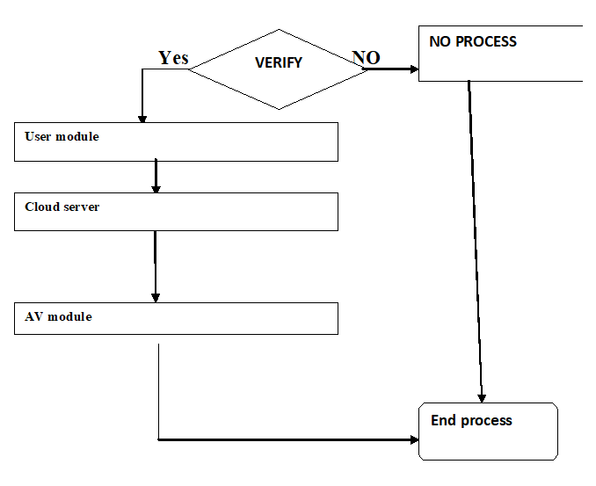
DATA FLOW DIAGRAM

Slide 19
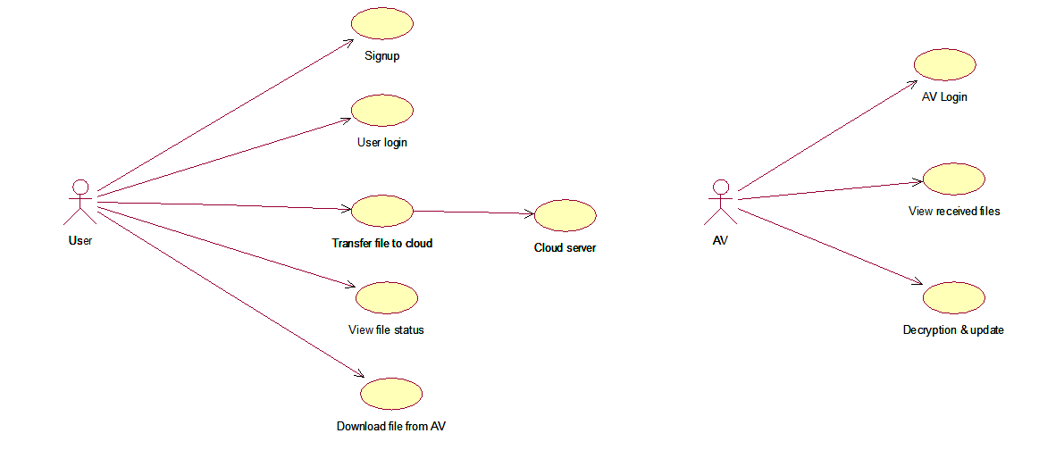
USE CASE DIAGRAM

Slide 20
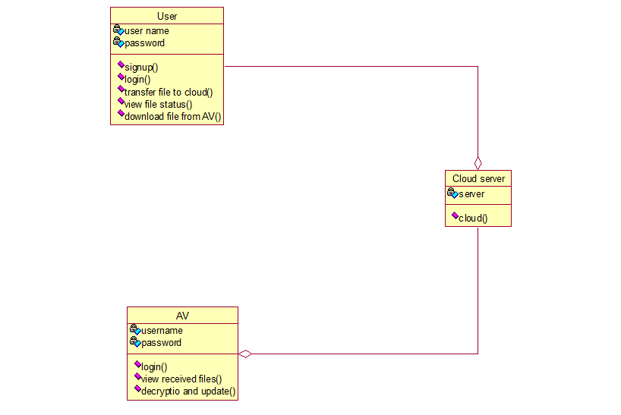
CLASS DIAGRAM

Slide 21
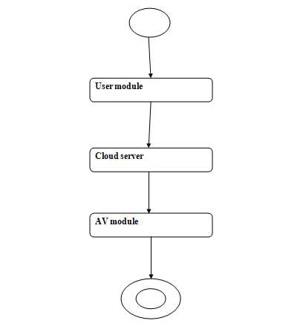
ACTIVITY DIAGRAM

Slide 22
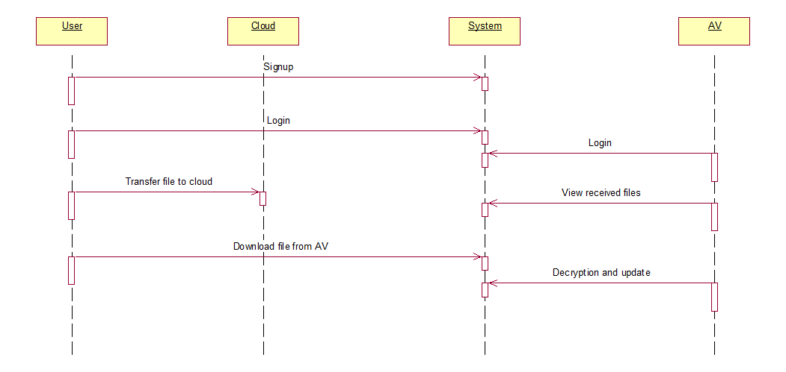
SEQUENCE DIAGRAM

Slide 23
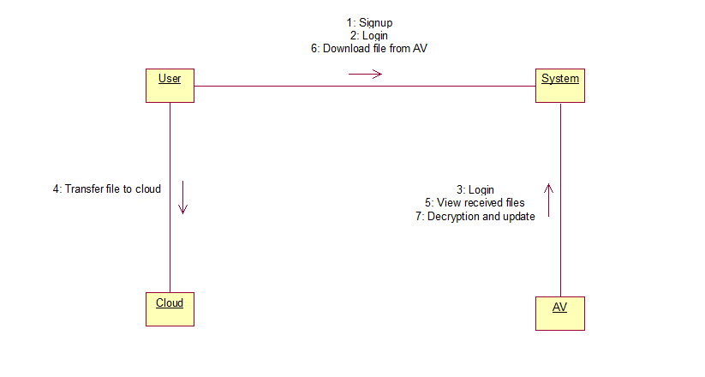
COLLABORATION DIAGRAM

Slide 24
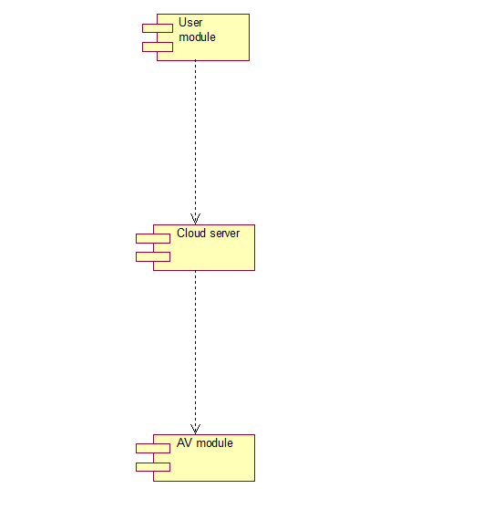
COMPONENT DIAGRAM

Slide 25
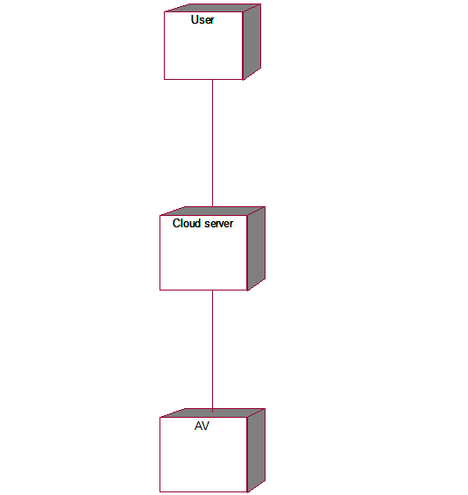
DEPLOYMENT DIAGRAM

Slide 26
IMPLEMENTATION
To implement this project we have designed two modules
User Module:**
The key features of this user module include:
- New User Signup:
This module allows a new user to sign up for the system. The user provides necessary information like username, email, and password to create an account.
- User Login:
Users who have signed up can log in using their credentials (username and password). This module authenticates the user and provides access to their account.
- Transfer File to Cloud:
Users can upload encrypted files to the cloud, which will be subsequently sent to the Autonomous Vehicle (AV). The uploaded files are encrypted using the CPABE algorithm.
- View File Status:
Users can view the upload status of their files. The system provides information about whether the file has been successfully received and updates from the AV.
- Download File from AV:
Users can download files from the AV that have been previously uploaded. The downloaded files are decrypted using the private key, allowing the user to access the original content.

Slide 27
2. Cloud Server:
- This module acts as an intermediary between users and the AV.
- It receives encrypted files uploaded by users and then forwards these files to the AV for further processing.
- It is responsible for managing the file transfer process between users and the AV.
3. AV (Autonomous Vehicle):
The key features of this module include:
- AV Login:
The AV can log in to the system using the provided username and password ('admin'/'admin').
- View Received Files:
The AV can view a list of files that have been uploaded by various users. These files are stored in an encrypted format on the AV.
- Decryption and Update:
The AV is responsible for decrypting the received files using the appropriate private key. It then updates the status of the file receipt, indicating whether the file has been successfully received.

Slide 28
CONCLUSION
Intelligence for Cloud-based Internet of Transportation Systems" successfully bridges the realms of cutting-edge technology and security in modern transportation networks.
By synergizing AI-driven anomaly detection and robust cyber security measures, the project contributes to safeguarding cloud-based transportation systems against emerging threats.
Continuous monitoring, adaptation, and collaboration are vital components in this evolving landscape.
Safeguarding transportation networks through comprehensive cybersecurity measures not only protects sensitive information but also contributes to the sustained efficiency and safety of advancement and interconnected systems.

Slide 29
REFERENCES
[1] R. Quinonez, J. Giraldo, L. Salazar, E. Bauman, A. Cardenas, Z. Lin, Securing Autonomous Vehicles with a Robust Physics-Based Anomaly Detector. 29th USENIX Security Symposium (USENIX Security 20). Boston, MA, August 2020.
[2] M. Masood, L. Khan, and B. Thuraisingham, Data Mining Applications in Malware Detection, CRC Press 2011.
[3] Y. Zhou, M. Kantarcioglu, B. M. Thuraisingham, B. Xi, Adversarial support vector machine learning. ACM KDD 2012: 1059-1067
[4] B. M. Thuraisingham, SecAI: Integrating Cyber Security and Artificial Intelligence with Applications in Internet of Transportation and Infrastructures, Clemson University Center for Connected Multimodal Mobility, Annual Conference, October 2019.
[5] B. M. Thuraisingham, P Pallabi, M. Masud, L. Khan, Big Data Analytics with Applications in Insider Threat Detection, CRC Press, 2017.

